Slide 1

Options to reduce operational impact and increase PNT resiliency
Dr. Andrew Hansen
OST-R/ Volpe Center Complementary PNT and GPS Backup Technologies Demonstration Team Representative
U.S. Department of Transportation
Notes:
Are these bullets associated with specific months?

Slide 2
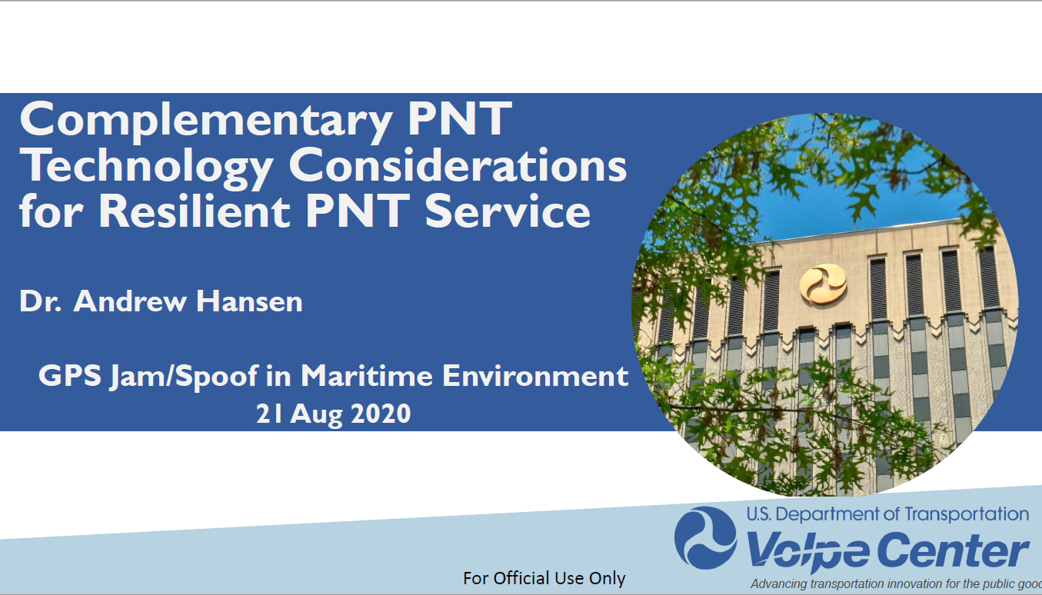

Slide 3
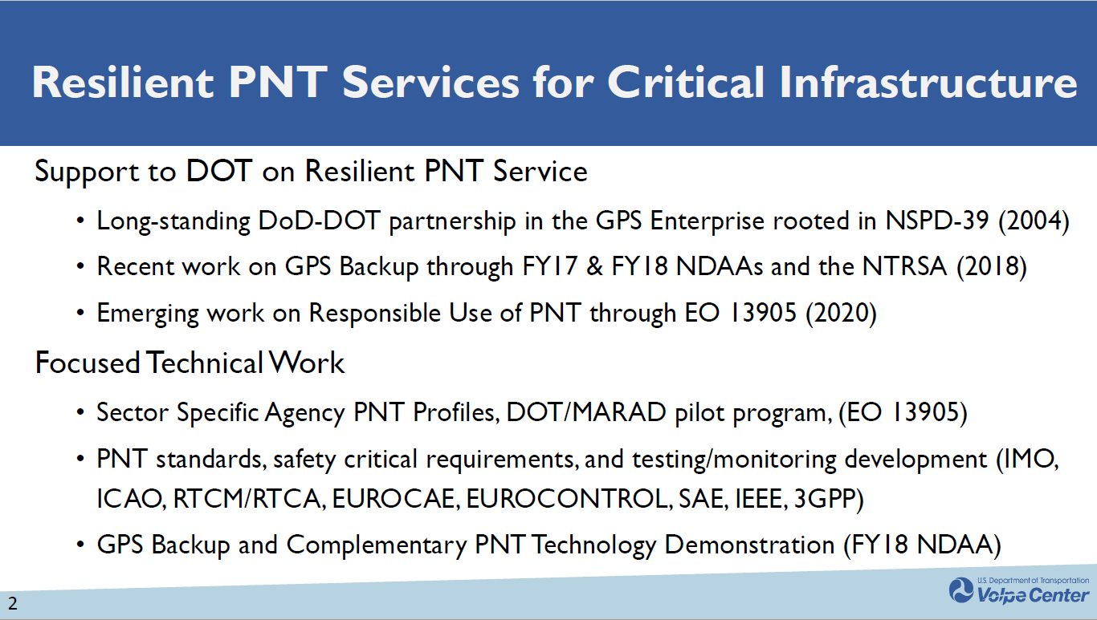

Slide 4
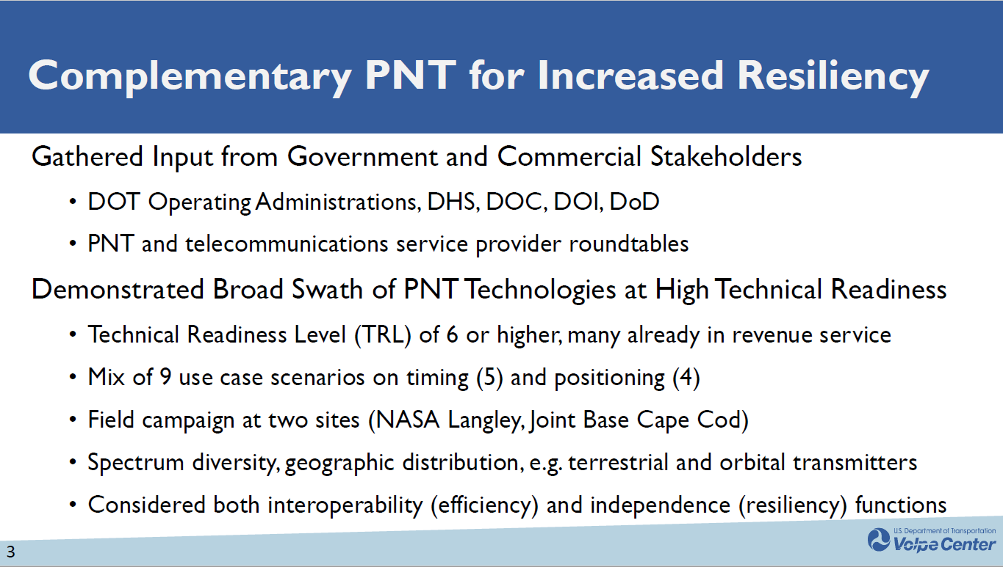

Slide 5
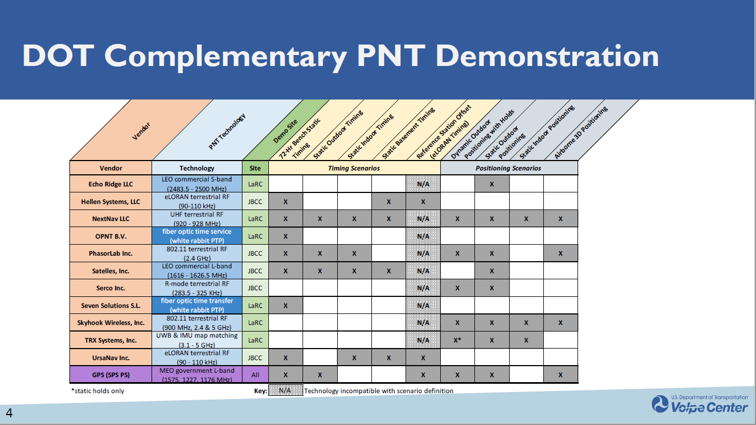

Slide 6
