Slide 1

Transportation Perspectives on PNT Resiliency
Workshop on GPS Jamming and Spoofing in the Maritime Environment
Department of Transportation
Office of the Secretary
Office of the Assistant Secretary for Research and Technology (OST-R)
December 3, 2020

Slide 2

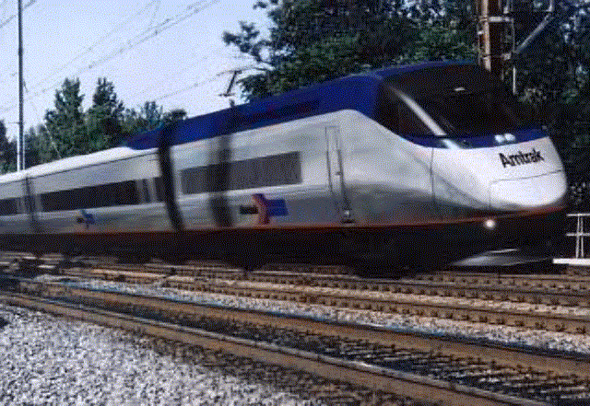
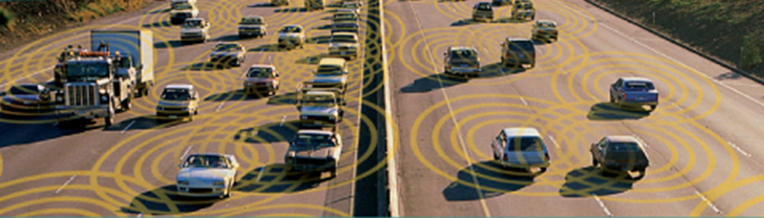


Reliable Navigation is Critical to Major DOT Initiatives
Aviation – NextGen
Reliable and accurate positioning worldwide
Reduced delays
More fuel-efficient routes
Increased system capacity with enhanced safety
Rail – Positive Train Control
Reduced probability of collisions
Increased efficiency and capacity
Intelligent Transportation Systems
Enable crash prevention among vehicles and between vehicles and infrastructure
Maritime
U.S. Department of Transportation
2
Notes:
Are these bullets associated with specific months?

Slide 3

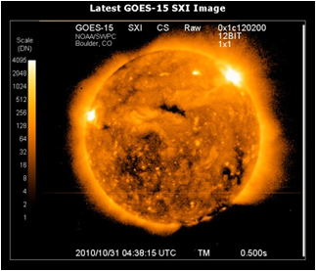




GPS/GNSS Challenged Environments
High Accuracy with Integrity
Timely Notification of
Misleading Information
Ionospheric Disturbances
Urban Canyons
Underground/Indoors
Inaccurate/Out-of-Date Maps
3
U.S. Department of Transportation
3
Notes:
Are these bullets associated with specific months?

Slide 4
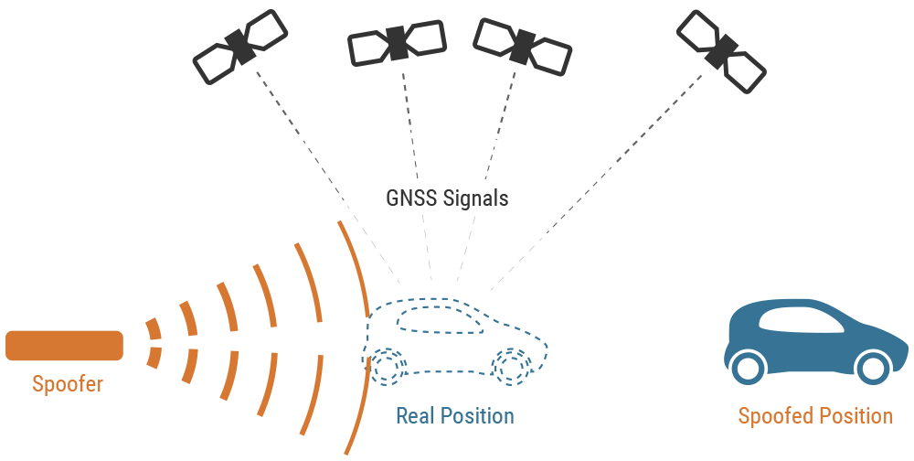
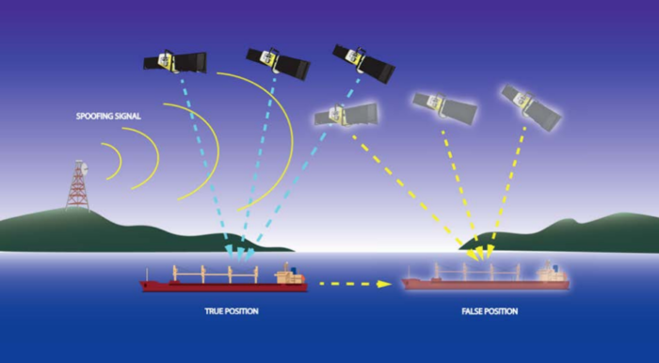

Existing GPS/Global Navigation Satellite System Threats
Jamming is intentionally produced RF waveforms that have the same effect as interference; the only difference is the intent to degrade or deny a target receiver’s operation.
Spoofing can deny, degrade, disrupt, or deceive a receiver’s operation and can have a range of effects from incorrect outputs of PNT to receiver malfunction. The onset of these effects can be instantaneous or delayed and it is possible for effects to continue even after the spoofing has ended. Ref. DHS Report “Improving the Operation and Development of Global Positioning System (GPS) Equipment Used by Critical Infrastructure”
2018 National Science Foundation grant to University of Virginia published: ROAD TO NOWHERE — $225 GPS Spoofer can send SATNAV-guided vehicles into oncoming trafﬁc.
U.S. Department of Transportation
Notes:
Space News quote attributed to DOT&E Director Robert Behler, 1 Feb 2020

Slide 5
FY18 NDAA GPS Backup Demonstration Status
Feb 19
Mar/Apr 19
Jun 19
Aug 19
Oct 19
Dec 19
Mar 20
May 20
Aug 20
Team Formed
Industry Round Table
Vendor RFI
FBO Rapid Acquisition
Vendor Contract Award
Scenarios & Field Sites Finalized
Dry-run & Demonstration
Internal Data Analysis
PNT EXCOM
  Awarded 11 PNT technology vendor demonstration contracts on rapid acquisition purchase orders through OST-R/Volpe Center
    Technologies included: Terrestrial RF, Low Earth Orbit, Fiber Optic, and Map Match
  Executed three field campaigns, technology demonstration, and analysis and assessment of data
  Report to Congress currently being drafted
U.S. Department of Transportation
Notes:
Are these bullets associated with specific months?

Slide 6
DOT PNT Research for Highly Automated Systems
PNT for Automated Vehicles (AV): ITS Joint Program Office
  AV use cases / scenarios
  Determine PNT requirements for AV operations
  Assess GNSS and other candidate sensor technologies
  Analyze PNT performance of individual sensors
  Determine navigation performance enhancements achieved by sensor fusion
DOT University Transportation Center: Highly Automated Transportation System Research
- Awarded to consortium led by The Ohio State University (with UC Irvine, UT Austin, and University of Cincinnati): Center for Automated Vehicles Research with Multimodal AssurEd Navigation (CARMEN)
  Assess PNT threat scenarios and risks to highly automated transportation systems
  Standards, Guidelines, and Best-practices for cyber-resilient PNT systems
OST-R Highly Automated System Safety Center of Excellence
U.S. Department of Transportation

Slide 7
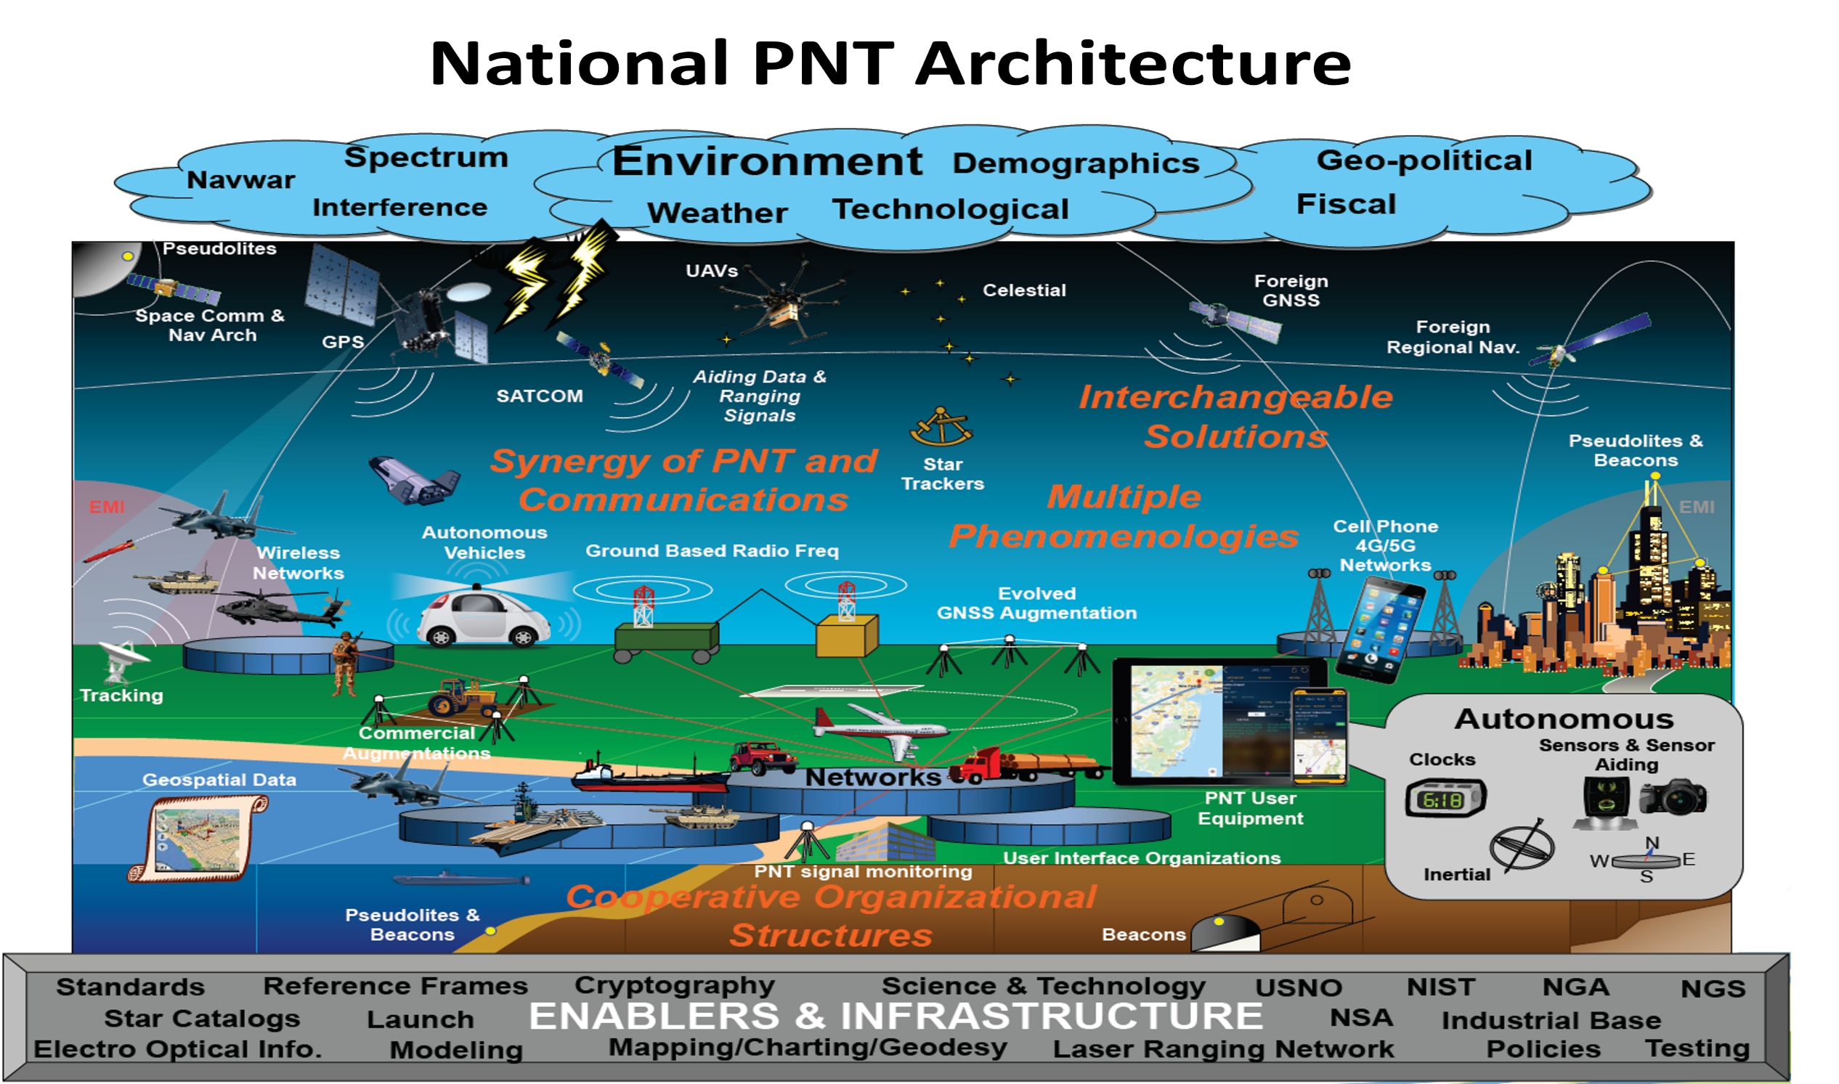
U.S. Department of Transportation

