Slide 1

What happens when PNT is denied, disrupted, or manipulated in a maritime environment
Captain William Westrem (Cont’d)
APL Maritime President Eisenhower
U.S. Department of Transportation
Notes:
Are these bullets associated with specific months?

Slide 2
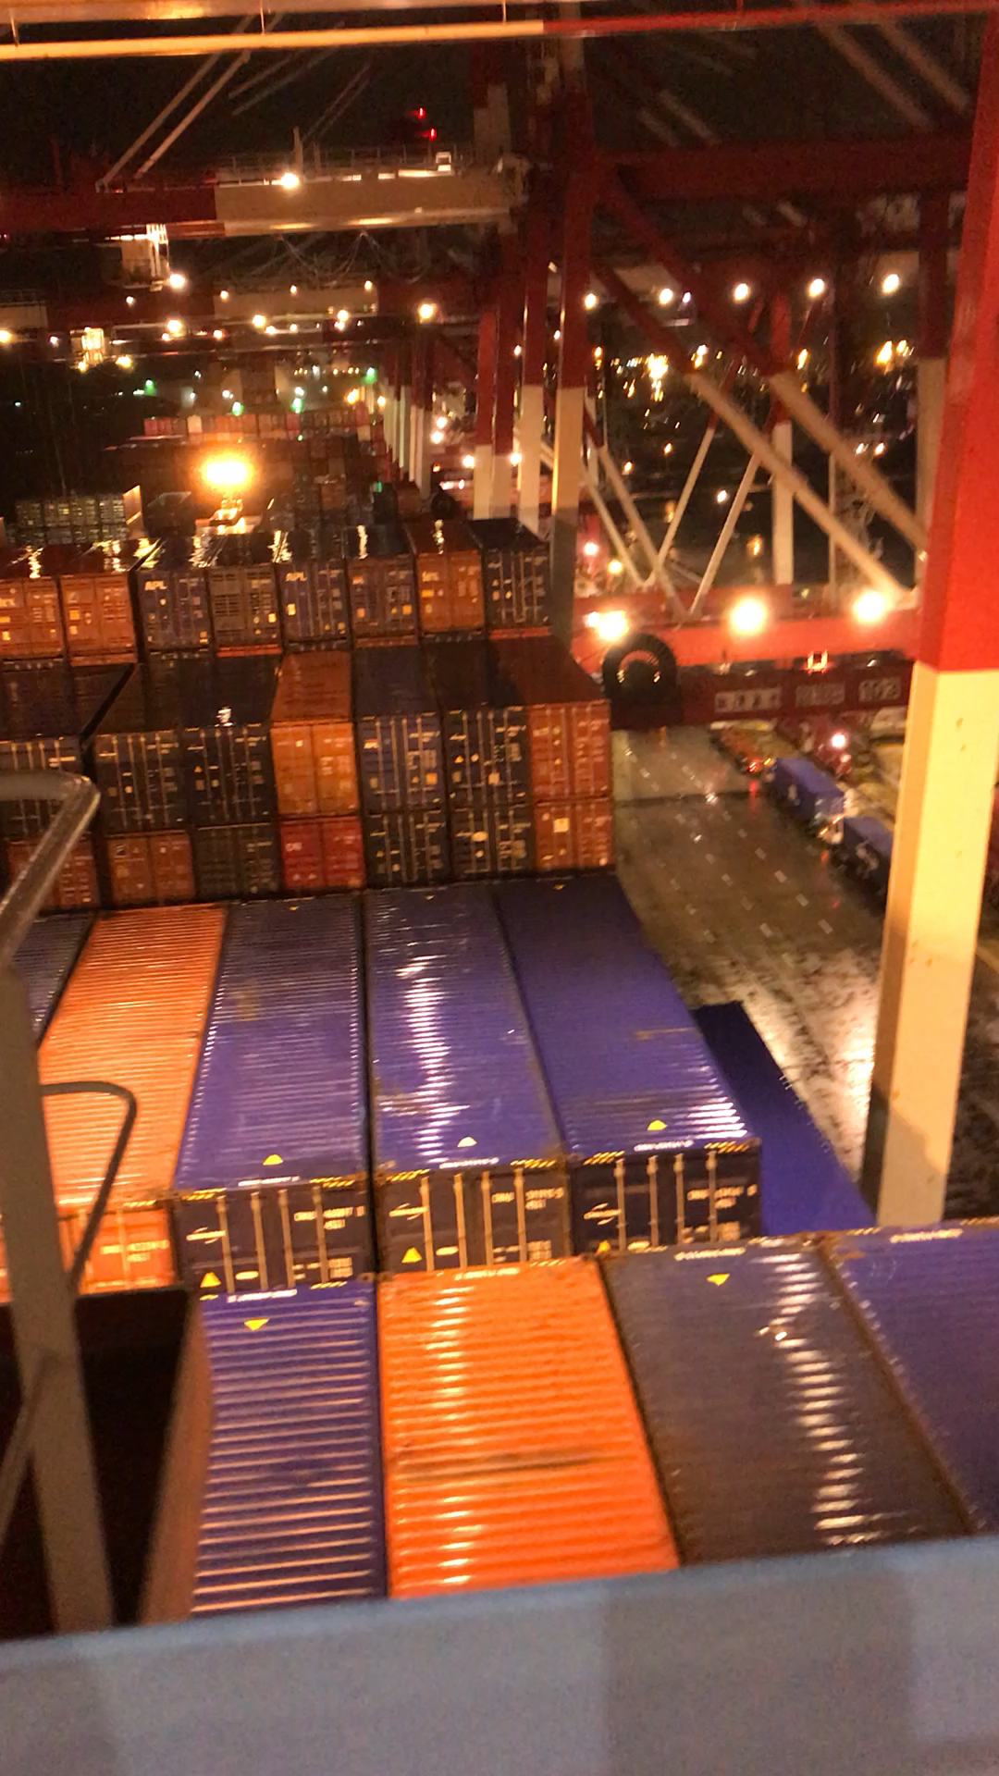
What happens when PNT is denied, disrupted, or manipulated in a maritime environment
Captain William Westrem
APL Maritime President Eisenhower
U.S. Department of Transportation
Notes:
Are these bullets associated with specific months?

Slide 3
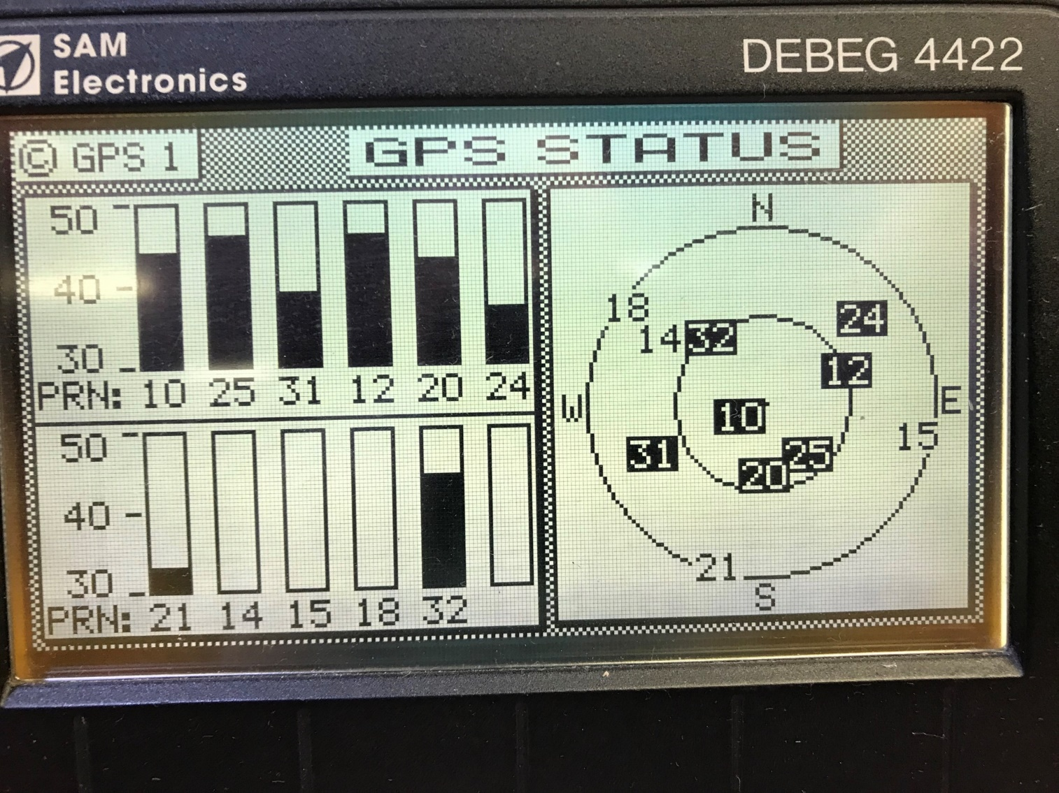
What happens when PNT is denied, disrupted, or manipulated in a maritime environment
Captain William Westrem
APL Maritime President Eisenhower
U.S. Department of Transportation
Notes:
Are these bullets associated with specific months?

Slide 4
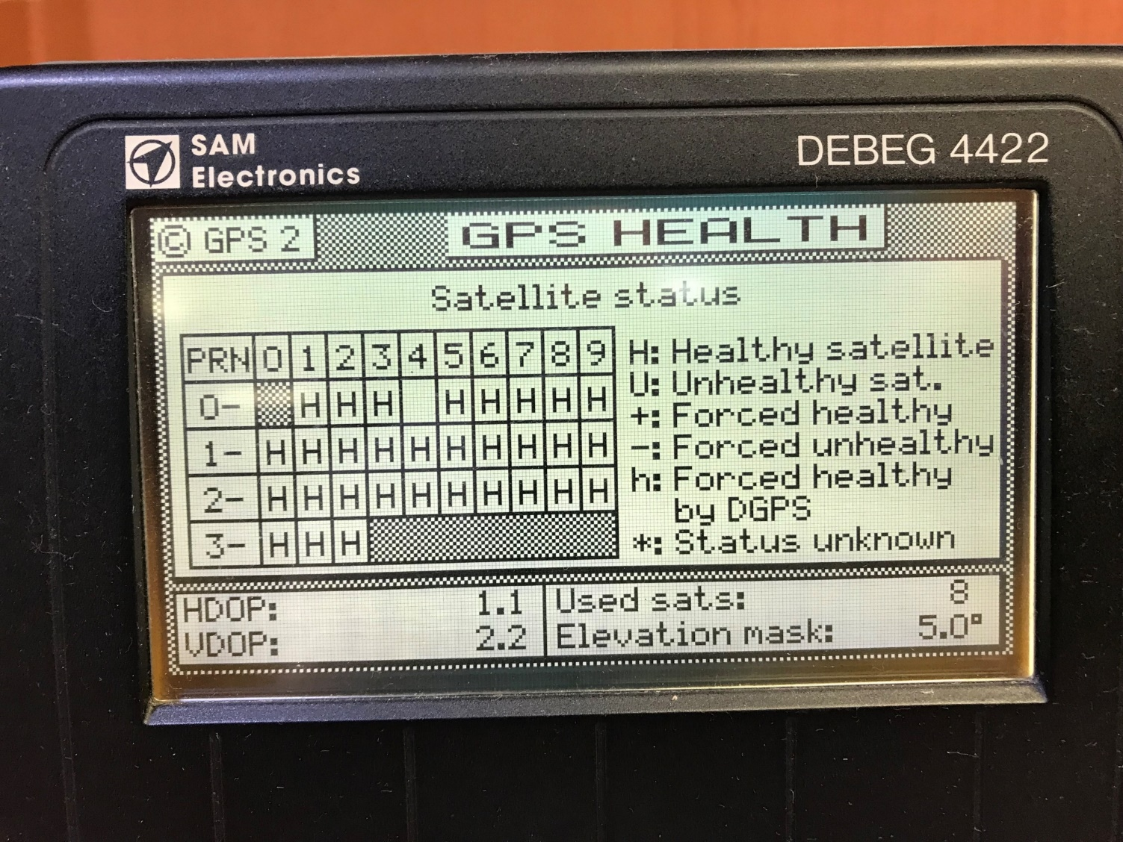
What happens when PNT is denied, disrupted, or manipulated in a maritime environment
Captain William Westrem
APL Maritime President Eisenhower
U.S. Department of Transportation
Notes:
Are these bullets associated with specific months?

Slide 5
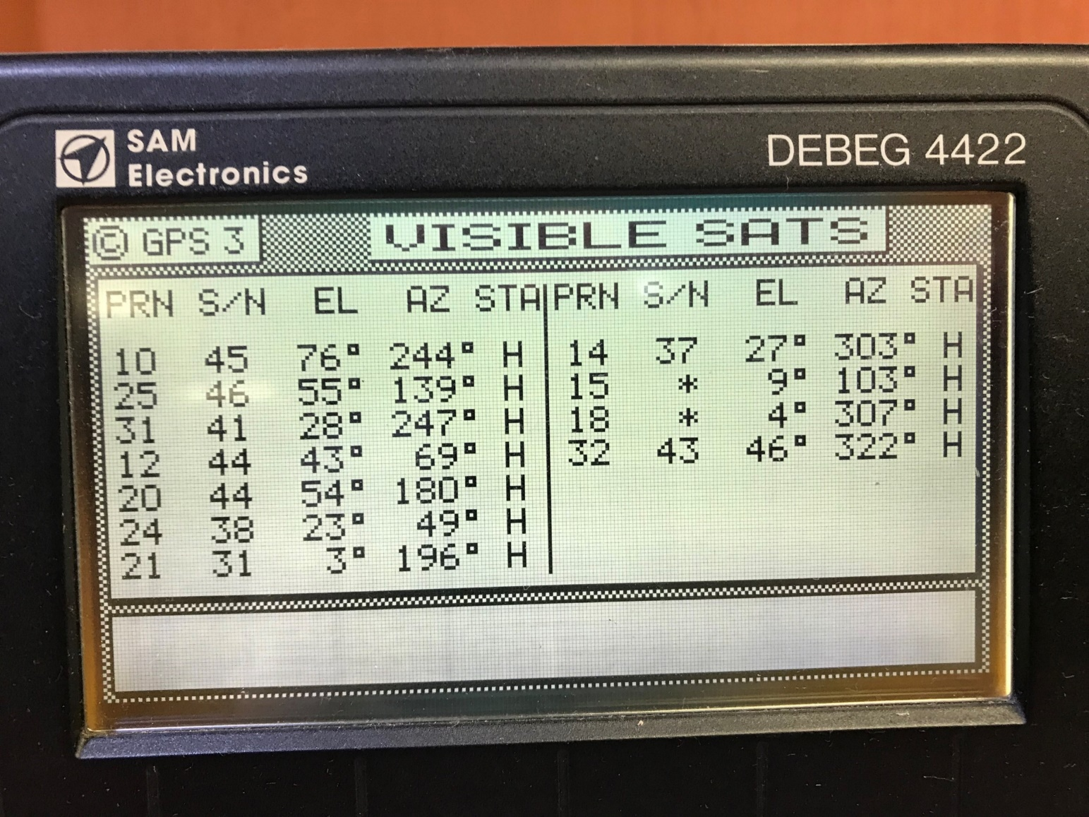
What happens when PNT is denied, disrupted, or manipulated in a maritime environment
Captain William Westrem
APL Maritime President Eisenhower
U.S. Department of Transportation
Notes:
Are these bullets associated with specific months?

Slide 6
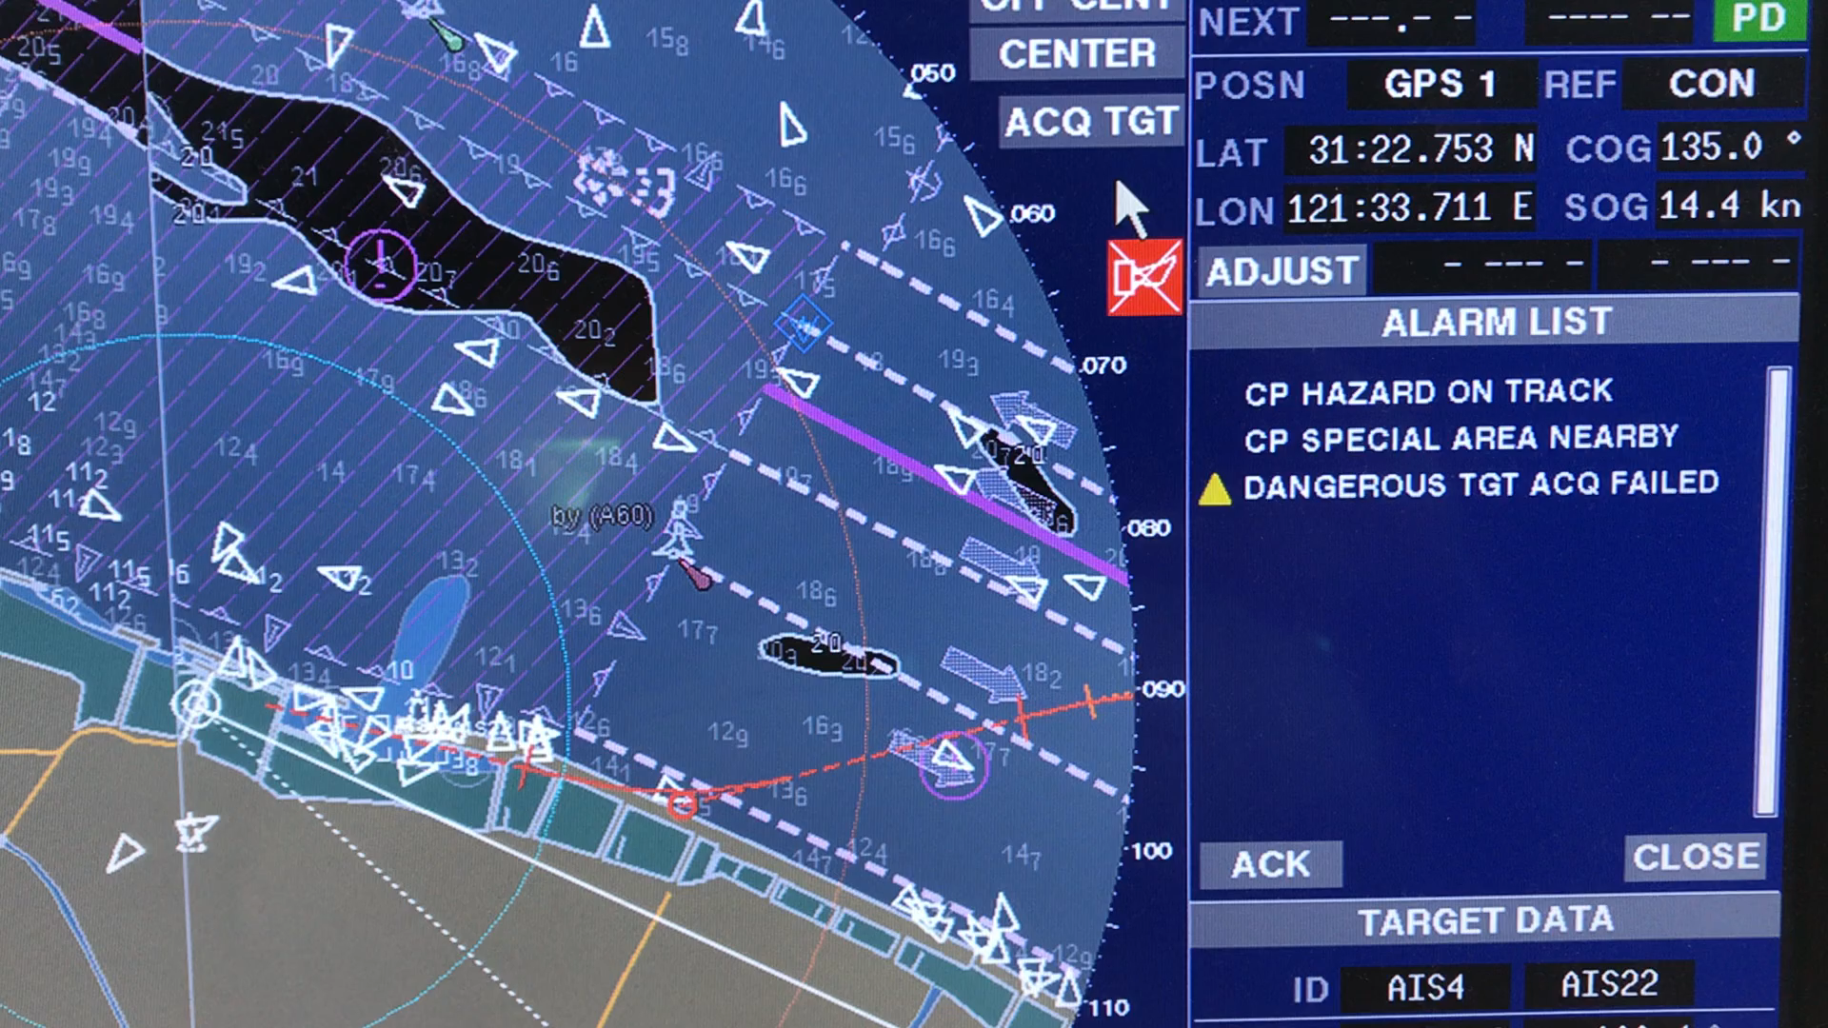
What happens when PNT is denied, disrupted, or manipulated in a maritime environment
Captain William Westrem
APL Maritime President Eisenhower
U.S. Department of Transportation
Notes:
Are these bullets associated with specific months?

