Slide 1

What happens when PNT is denied, disrupted, or manipulated in a maritime environment
Dana Goward
President & Director, Resilient PNT Foundation
U.S. Department of Transportation
Notes:
Are these bullets associated with specific months?

Slide 2



How To Steal A Ship
GPS Vulnerability & Maritime
3 Dec 2020
US DOT Research & Technology
Notes:
Thanks for the introduction and the opportunity to be here today. Our organization is a scientific and educational charity dedicated to protecting GPS signals and users/

Slide 3

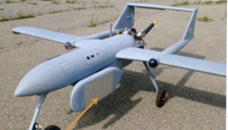
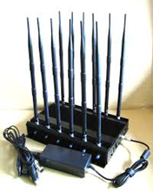
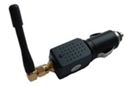
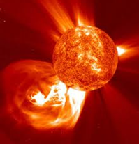
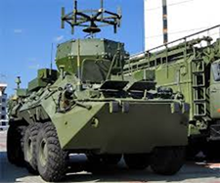
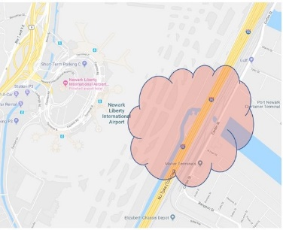
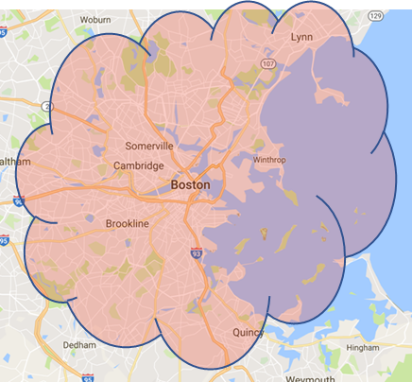
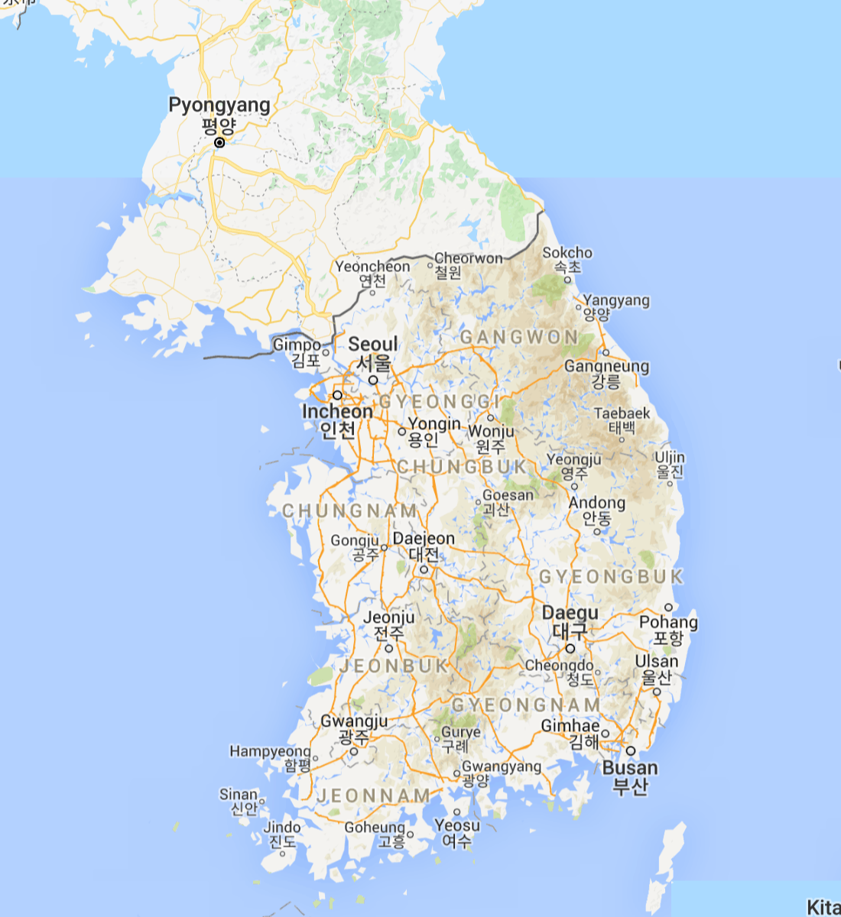
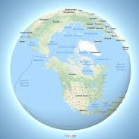
Jamming
Boston
Newark Intl EWR
Seconds,
Minutes
Weeks +
Notes:
Which is the exact opposite of what GPS jamming does. Jammers come in all sizes, shapes and power levels. The sun is the most powerful potential jammer of all with large solar flares capable of damaging satellites or charging the ionosphere and preventing signals from getting through.

Slide 4
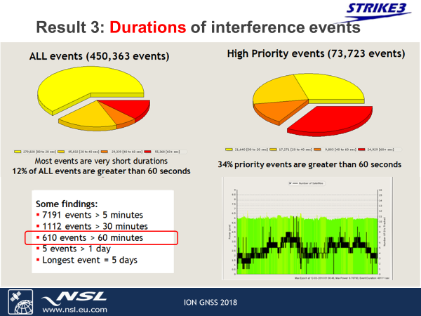
European Commission Project
Notes:
But does jamming happen often? Yes. During a two year sampling a European Commission project found more than 450 thousand instances, about 10% of which were judged to be deliberate jamming. The rest was accidental from other sources of radio noise.

Slide 5
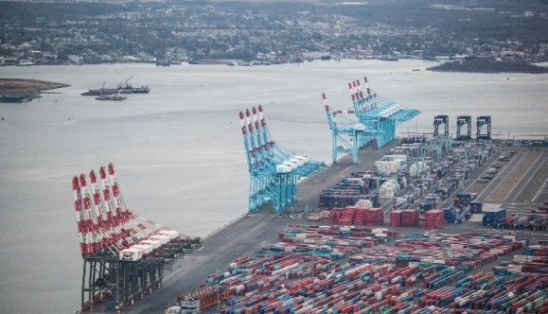
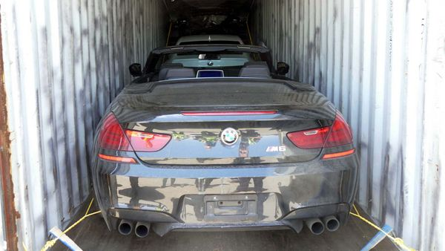

Impacts Entire Supply Chain
“GPS Disruption Halts Ports, Endangers Ships” – US Coast Guard
Jammers aid auto & cargo theft
Notes:
And this can have a real impact on maritime. It can shut down ports, aid in cargo thefts and with illegal transportation.

Slide 6
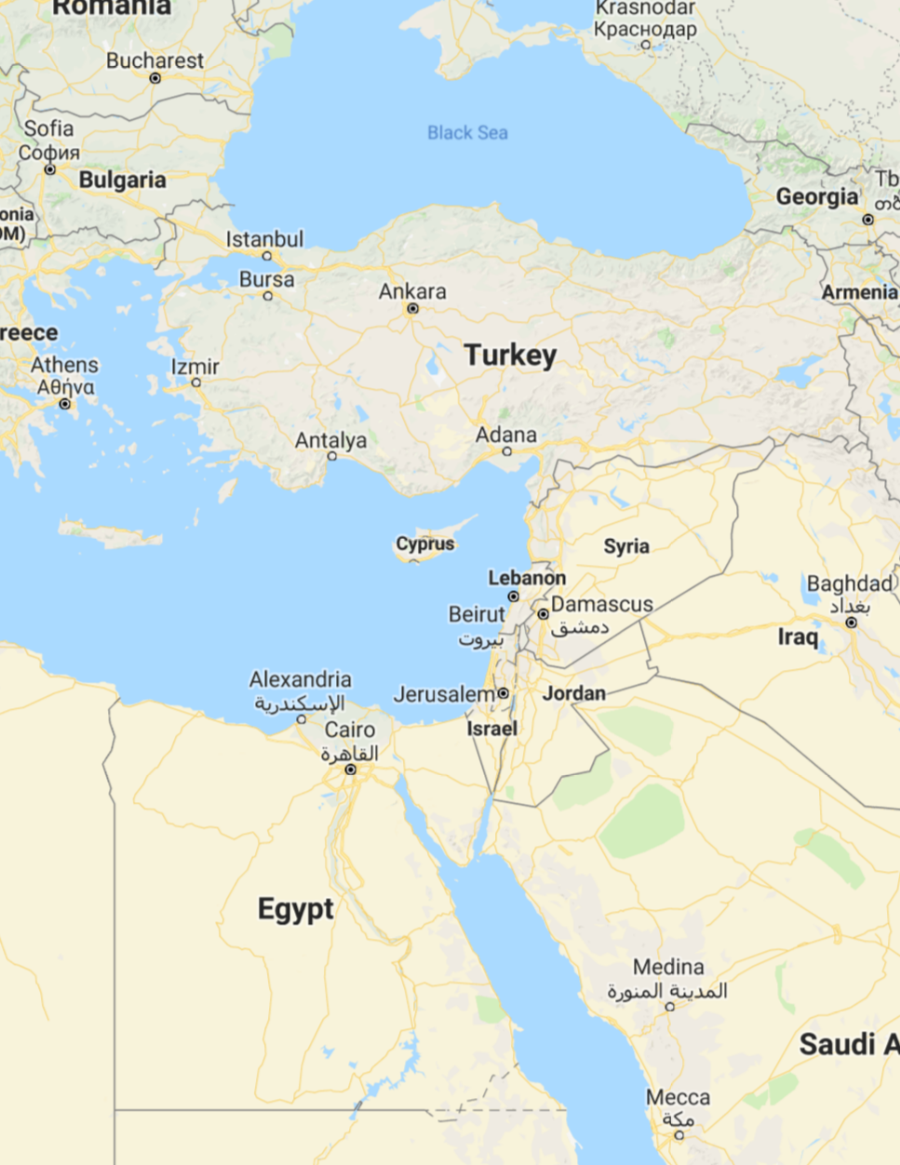
Maritime
Jamming Reports
VIP Protection & Conflict
Disrupt Oil/Gas Surveys?
Armed
Conflict
Illegal Fishing?
Unknown
Notes:
And of course it is a problem for ship operations. Probably everyone is familiar with MARAD’s advisories about the eastern Mediterranean.

Slide 7

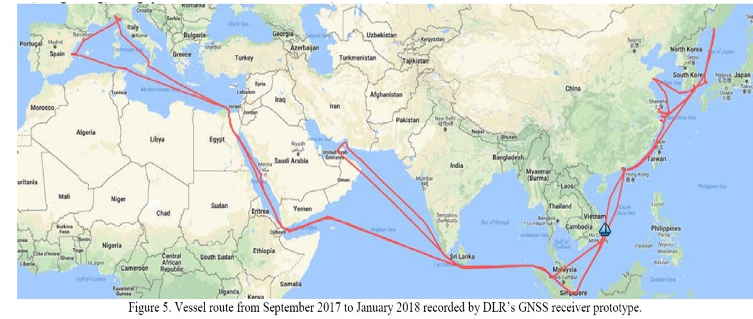
Year-Long ocean cruise finds GPS disruption… everywhere
13 March 2019
Notes:
But it is really a global problem. Stray signals on GPS frequencies, many strong enough to interfere with navigation were detected in every phase of this voyage by a German research center.

Slide 8

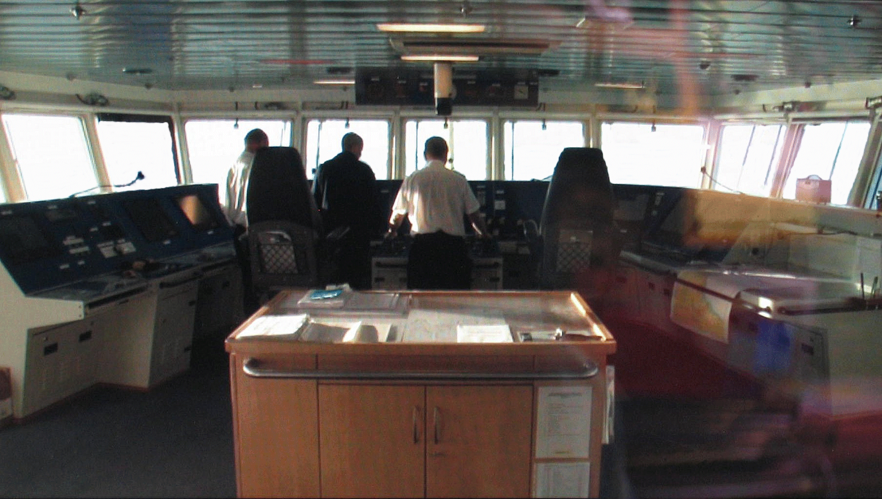
Low-powered GPS jammer
First indications:
False positions, and velocities
Autopilot may turn vessel
But no alarms!
With a little more jammer power:
Electronic Chart Displays
Autopilot
Automatic Identification System
Differential GPS
Satellite voice and data comms
Maritime distress safety system
plus …
Ship’s Radar & Gyrocompass
© David Last
Notes:
So what can happen when a ship gets jammed? Our friends in the UK did it on purpose to find out. The fist thing is that the nav plot begins to wander off, without giving any warning of malfunction. Then, almost all the red lights on the bridge illuminate. Even things you wouldn’t guess had GPS inputs.

Slide 9
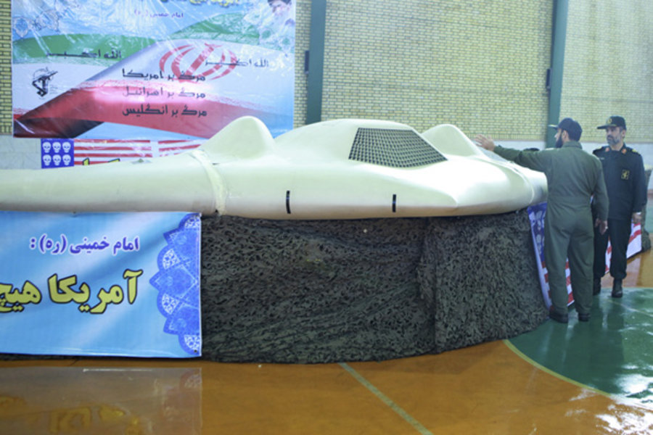
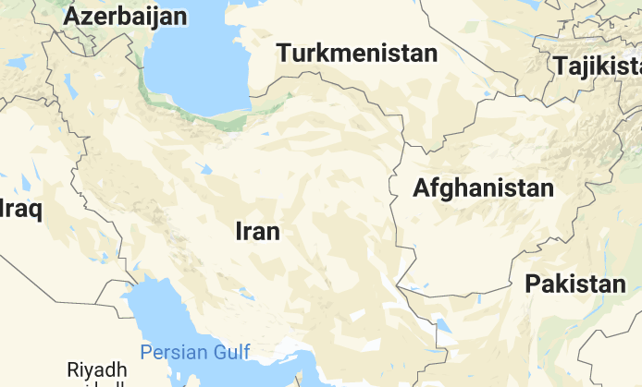
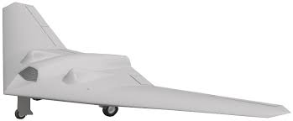
Spoofing – Hazardously Misleading Information
December 2011
Notes:
So that’s jamming. This is the first public report of GPS Spoofing. In 2011, a CIA drone operating in Afghanistan was spoofed by Iranian forces into crossing the border and landing in Iran. At first, US government officials said spoofing wasn’t possible.

Slide 10
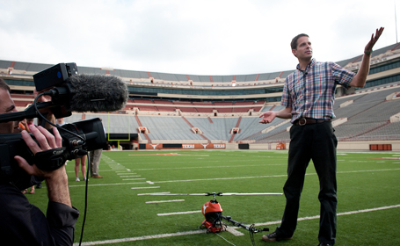
Spoofing Demo
June 2012
University of Texas, Austin
Prof Todd Humphreys
Notes:
Then Professor Todd Humphries at the University of Texas said “Of course it is. Watch.” and showed how it was done..

Slide 11
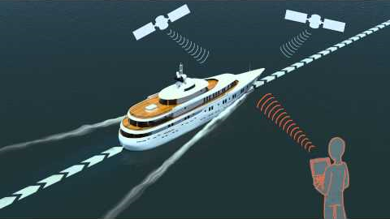
Spoofing Demo
June 2013
https://www.youtube.com/watch?time_continue=17&v=ctw9ECgJ8L0
Notes:
The following year, he did it to a manned vessel with an alerted and attentive crew.
Roll film, please.

Slide 12
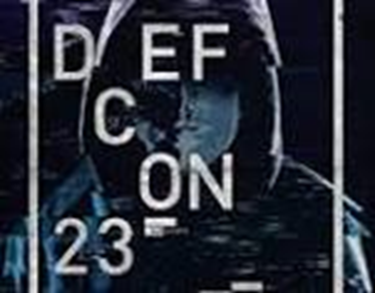

Tutorial – Build Your Own GPS Spoofer
December 2015
Hackers Convention
Las Vegas
Notes:
A couple years went by and the ever inquisitive and innovative hacker community brought this capability to the general public, or at least the general hacker population.
This young lady from China provided a step by step tutorial at a convention on how to build and operate a spoofing device. She also sold kits for around $300.

Slide 13
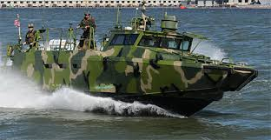
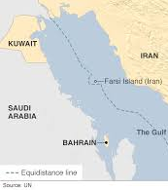
January 12, 2016
Reposition 2 RCB 90s from Kuwait to Bahrain through International Waters
Notes:
The very next month saw an even more dramatic case. Two US Navy boats started out on a routine trip from Kuwait to Bahrain. But they got lost in hazy weather and ended up in Iranian waters where the Iranian Navy was waiting in force.

Slide 14


January 12, 2016
Spoofing?
Right after US/Iran nuclear agreement
Same day as President’s last major speech to the nation
Notes:
This was right after President Obama had pressured that country into an agreement to not build nuclear weapons, and on the day of his last major speech before leaving office. For the record, US officials said it wasn’t spoofing – though they offered no other explanation for why the boats were so far off course.

Slide 15
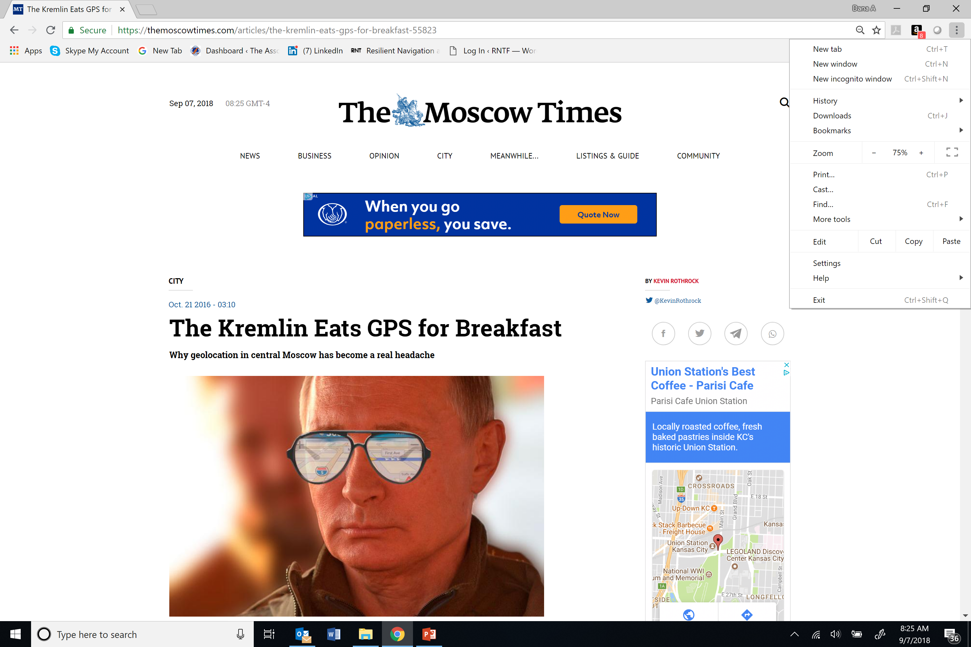
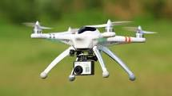
Notes:
Russia has been spoofing GPS for years in the vicinity of the Kremlin as a way of protecting VIPs from drones. It is often impossible to get an Uber in central Moscow because your phone shows you at the airport 20 km away.

Slide 16
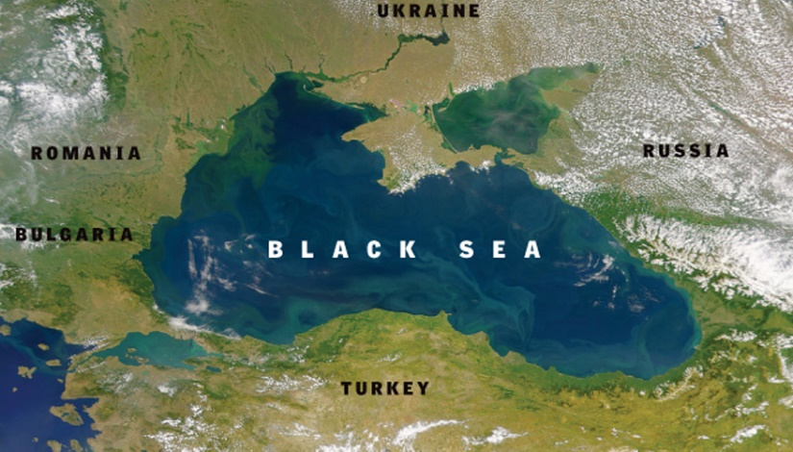
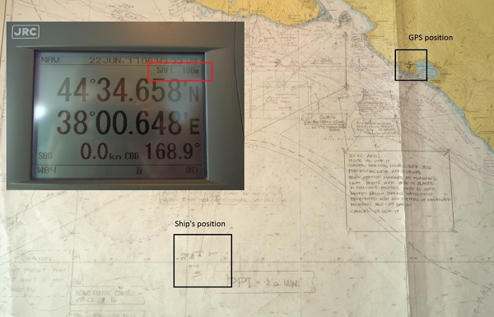
June 2017, M/V Atria
Images
CAPT Gurvan LE MEUR
Motor Vessel Atria
Notes:
This was detected in the Black Sea in 2017.

Slide 17
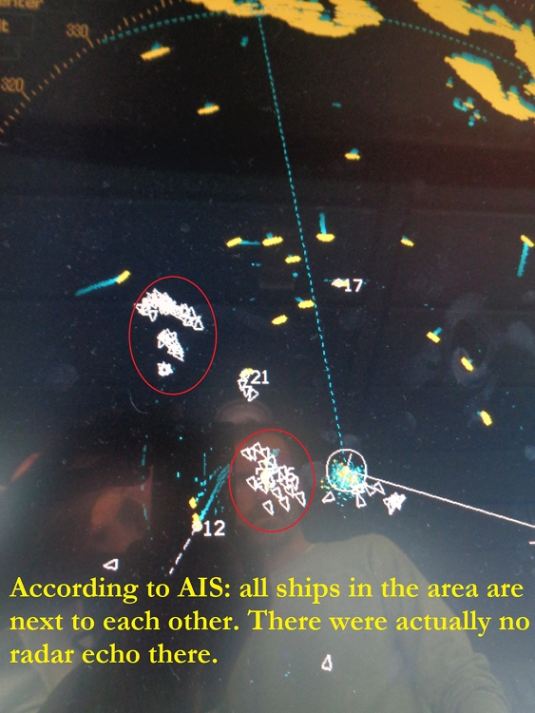
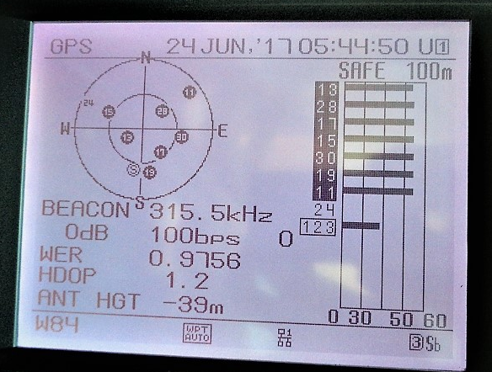
June 2017, M/V Atria
Images
CAPT Gurvan LE MEUR
Motor Vessel Atria
Notes:
A group of 20 vessels offshore reported their positions at an airport miles away. As you can see here, at least one GPS receiver showed that it was working perfectly, and that its antenna was 39 meters under the water. Our non-profit documented all of this and reported it in the press.

Slide 18
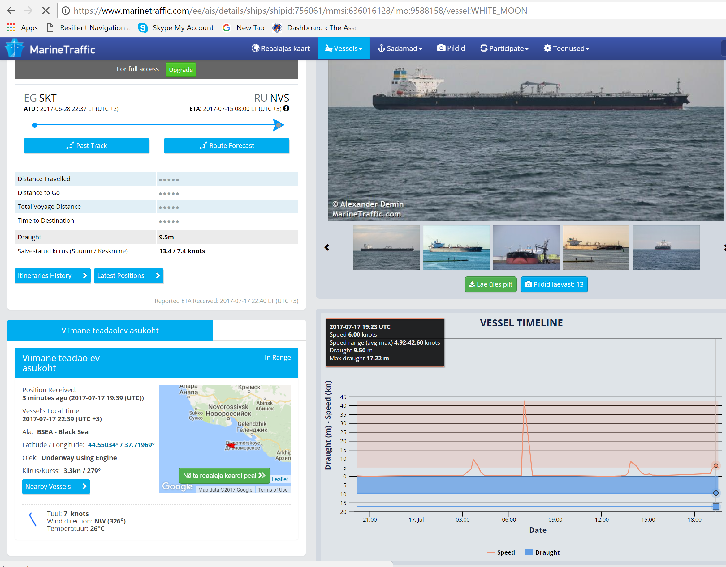
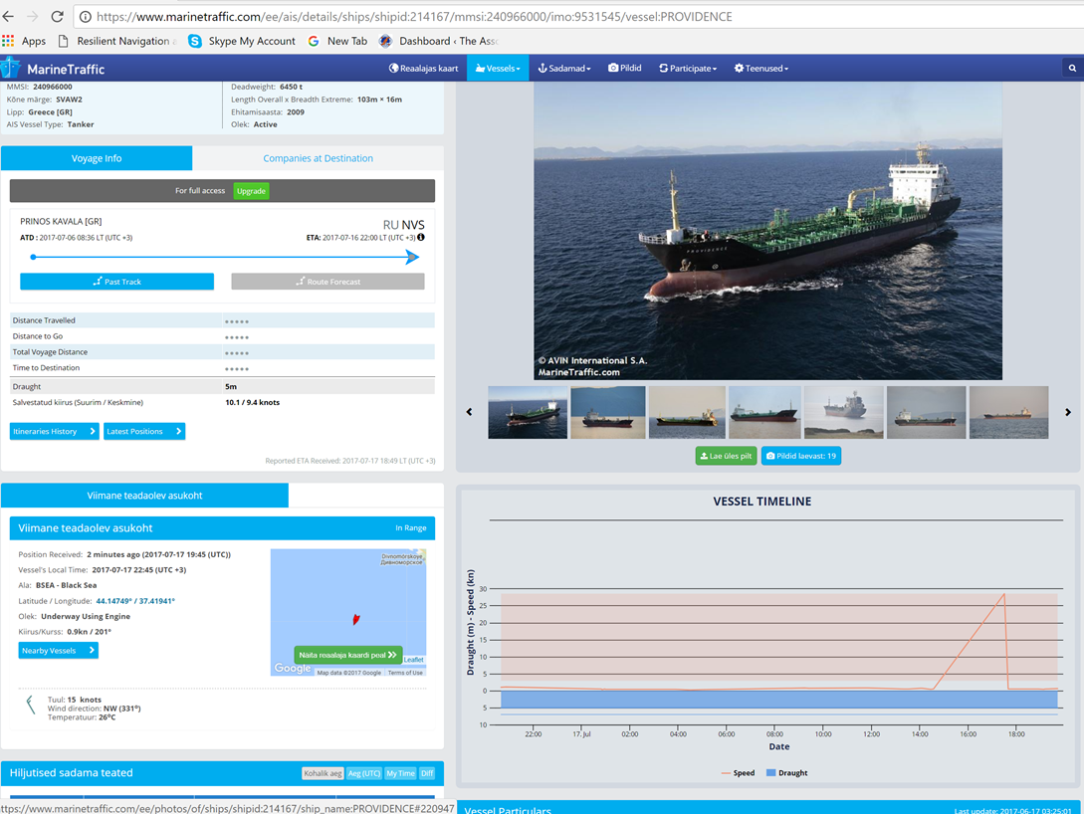

July 2017
Notes:
The next month we looked at a sample of ships in the Black Sea and found this was still happening and issued another report there was a consistent pattern of spoofing

Slide 19
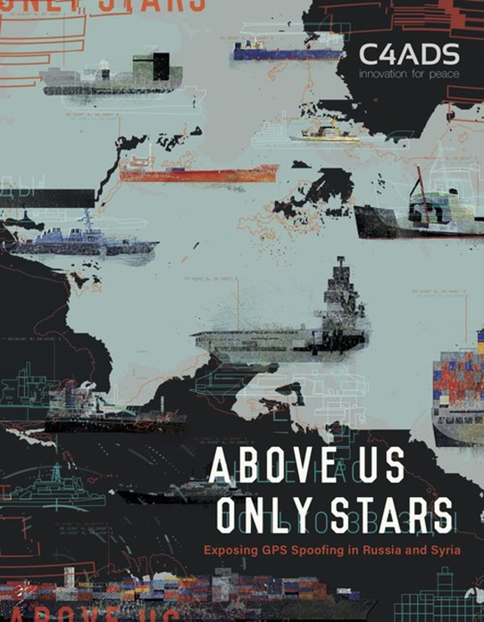
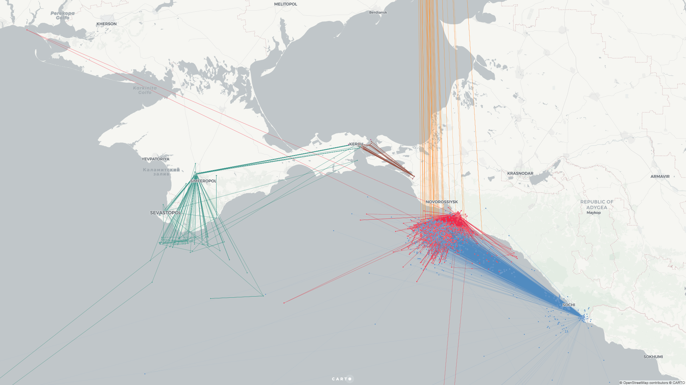
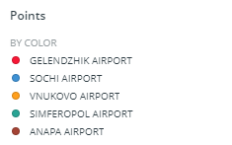

Black Sea Spoofing Activity
January 2016-November 2018
https://c4ads.org/reports
Unless specifically stated, the mention of any company, organization, individual, or other entity in this document or any attachments thereto does not imply the violation of any law, statue, or international agreement, and should not be construed as such.
Notes:
In 2019 another non-profit looked at almost two years of data and found almost 3,000 ships impacted, all reporting that they were ashore at Russian airports.\

Slide 20

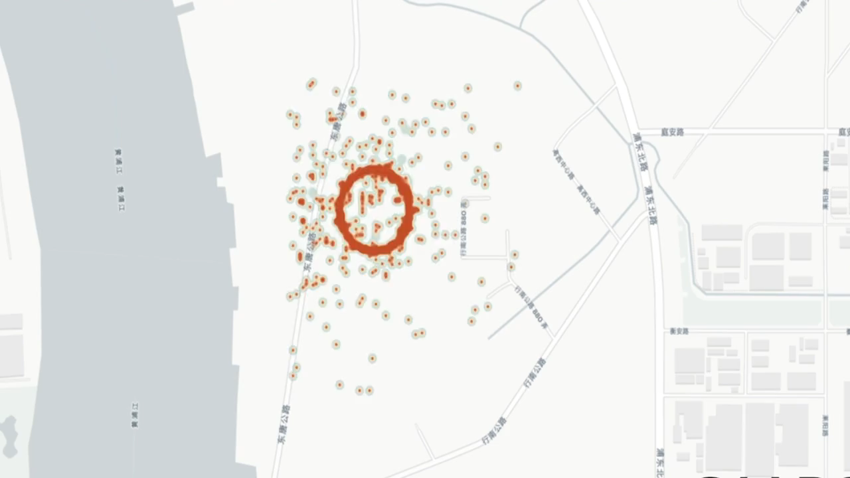
Port of Shanghai, People’s Repubic of China
Notes:
This last year the Chinese have gotten into the act. They seem to have wanted to spoof receivers to random locations. But there is something about their hardware or software that, when you look at the spoofed positions aggregating over time, puts many of them in a circle, probably around the location of the spoofing device.

Slide 21
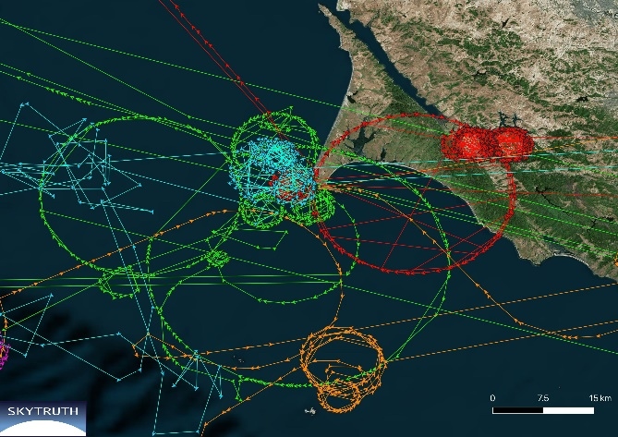
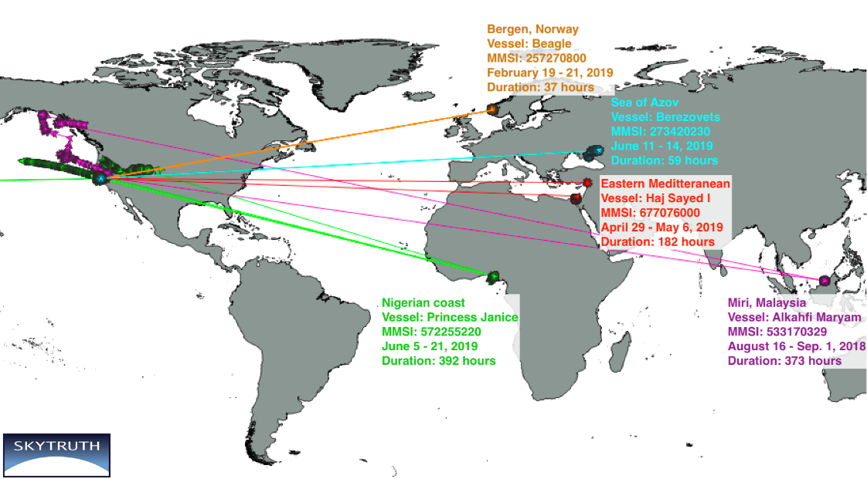
Notes:
This technology seems to have migrated to the dark market as we have observed vessels in far flung places around the globe reporting they sailing in circles near PT Reyes in Northern California.

Slide 22
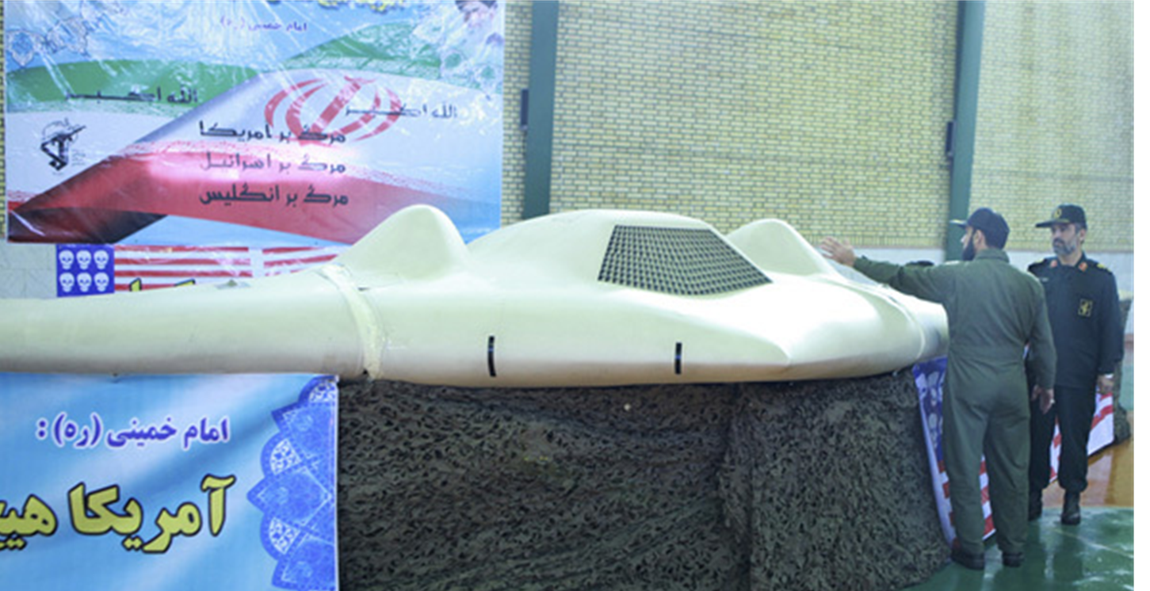
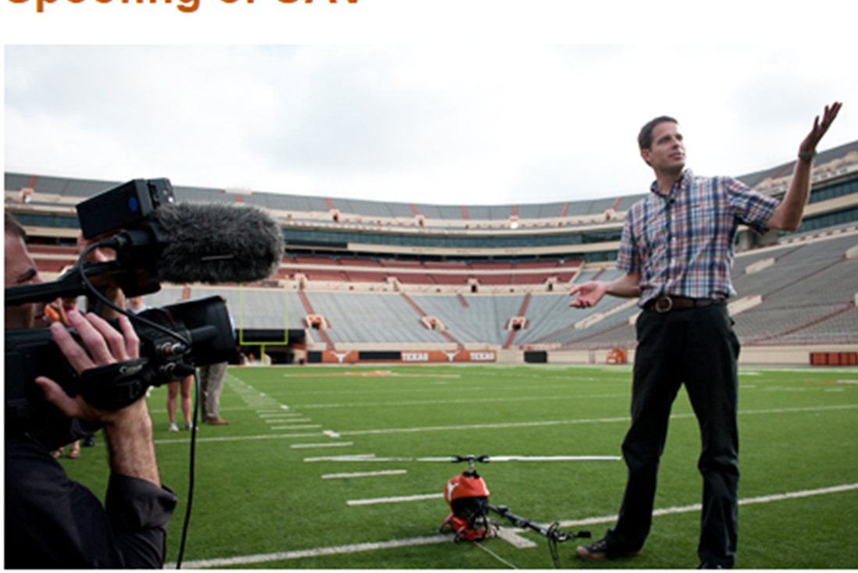
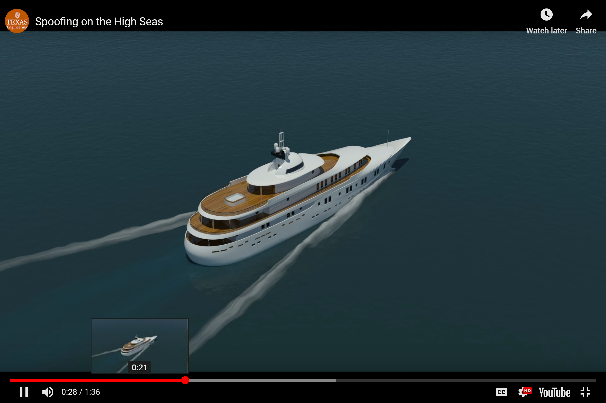

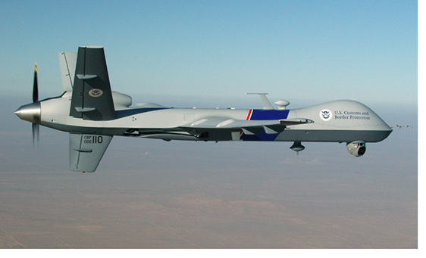


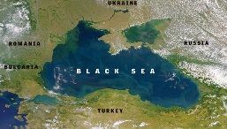


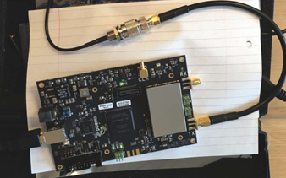
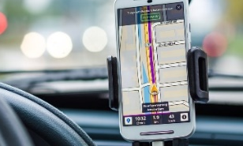
Spoofing – Cost ↓ Capability ↑ Ease of use ↑
Iran, Dec 2011
UT Austin, 2012-13
Las Vegas, Dec 2015
US Southern Border
Dec 2015
Persian Gulf, Jan 2016
4 sites Russia
1,300+ ships
2016 - Present
Pokemon
July 2016
Portland
Oct 2017
All GNSS at Once June 2018
Signals & Maps
Jul 2018
Notes:
As we have watched spoofing develop over the years, it has followed the same path as many technologies – it has gotten less expensive, more capable and easier to use. Today with a couple hundred dollars in equipment, a reasonably capable consumer can spoof all the world’s satnav systems at once, and evenprovide false maps to lure users into locations they might not want to be.

Slide 23
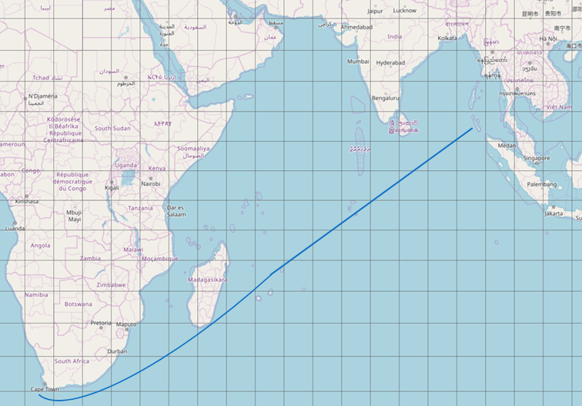

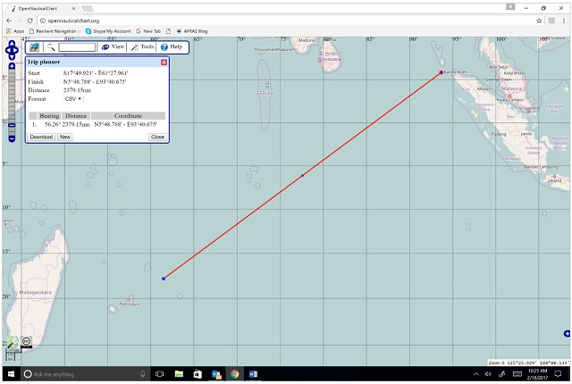
“How To Steal A Ship”
2 June 2017
Change Course 5º to right
Increase speed 2 knots
Notes:
But can you steal a ship? It is possible to do to a major vessel what Professor Humphries did to the yacht?
Imagine a container ship enroute from Europe to Japan.. If once the ship is beyond the sight of land a spoofer device that had been smuggled aboard is used to slightly alter the vessels’ course and speed….

Slide 24
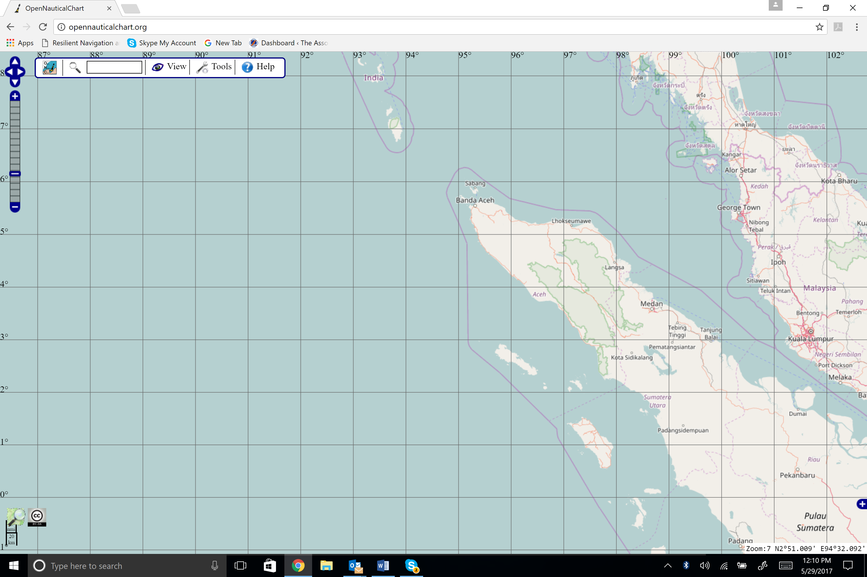
Western Entrance to Malacca Straights, High Vessel Traffic Area
Victim makes landfall 10 hours early & 220nm away near “lightly governed” area.
Notes:
Instead of entering the Straits of Malacca on schedule and on course to its destination, it could arrive ten hours early in an area known for piracy.
Just one possible scenario. Very unlikely. I am sure it will never happen.

Slide 25

What to Do?
Protect – GPS Signals
Toughen – Users & Equipment
Augment – w/other signals & sources
Notes:
So, what to do?
Our non-profit supports the holistic approach recommended by the US National Space-based Positioning, Navigation, and Timing Advisory Board that three things are necessary to protect our nation. We must all protect signals, use better equipment and add additional nav signals and sources to GPS.

Slide 26

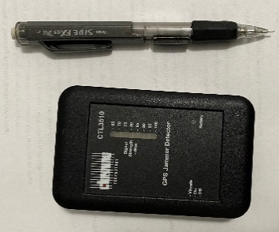
What to Do? - Masters
How To Steal a Ship, Part 2
12 June 2017
Protect –
  Who and What is Aboard?
  Interference detection
Toughen –
  Secure proximity to GPS/GNSS antennas
  Standards, requirements, costs
Augment –
  Prudent mariner - “Every means available”
Notes:
Masters need to understand who is aboard their vessel and any unusual equipment that is brought aboard. Perhaps even purchasing a simple interference detector like this one. They can also keep passengers and crew away from antennas and advocate for better equipment, as well as ensuring that bridge crews confirm GPS information with other navigation information.

Slide 27
What to Do? - Companies
How To Steal a Ship, Part 2
12 June 2017
Protect –
  Support masters per above
Toughen –
  GPS receivers w/ anti-jam & anti-spoof
  GNSS receivers using multiple constellations
  Two antennas
Augment –
  Loran, eLoran, Chayka
  Engage w/ Govts, IMO, etc.
Notes:
Ship operators have a role also in the way they equip their vessels and what they insist on from governments. For example there have been several studies showing that a difficult to disrupt terrestrial navigation system is needed to support maritime commerce regardless of the status of space-based signals. Yet only a few coastal nations have such a system.
Operators should also support their masters in using all available means to navigate safely.

Slide 28
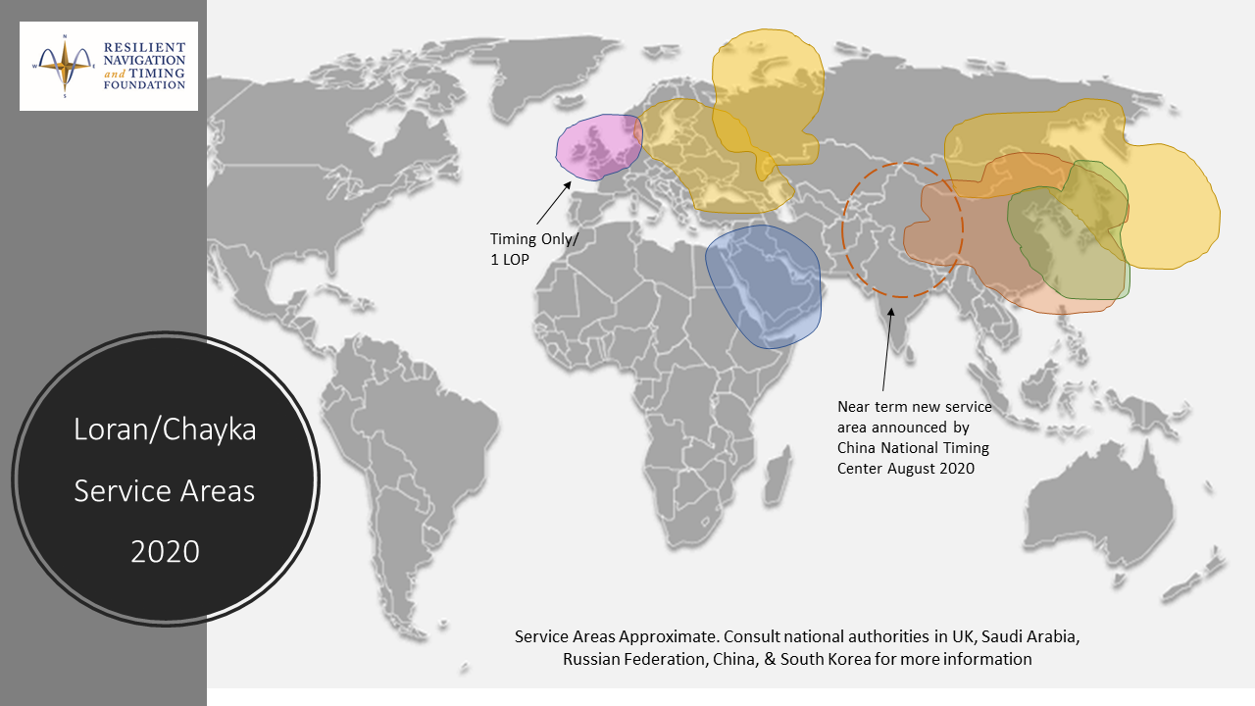
Notes:
For example, the parts of the world most prone to GPS disruption, also have Loran signals available, but how many ships not homeported in China, Russia, or Korea are able to use them?

Slide 29
What to Do? - Nations
How To Steal a Ship, Part 2
12 June 2017
Protect – GPS Signals
  Interference detection
  Enforcement
Toughen – Users & Equipment
  Anti-jam, anti-spoof
  Standards, requirements, costs
Augment – w/other signals & sources
  US Govt Announcements 2008, 2015 “eLoran”
Notes:
And finally, national governments have a responsibility to focus on and lead coherent PNT programs for civil use. In the US the Dept of Transportation has been working valiantly on this for years. This event is but one small example. But DOT has not received nearly enough support for their efforts. I propose that we all not only give them our heartfelt thanks, but also pledge to insist that folks in Congress and the Administration pay attention to this challenge and give DOT the money and other resources they need to make American navigators bulletproof.

Slide 30

The Resilient Navigation and Timing Foundation is a 501(c)3 scientific and educational charity registered in Virginia
www.RNTFnd.org
Notes:
Thanks again to Karen and crew for inviting me to speak and to you for your attention. I invite you to visit our website and am happy to take your questions if we have time.

